Slide 1
Java strings

Slide 2
String introduction
In Java, a string is a sequence of characters. For example, "hello" is a string containing a sequence of characters 'h', 'e', 'l', 'l', and 'o’.
We use double quotes to represent a string in Java. For example,
// create a string String type = "Java programming";

Slide 3
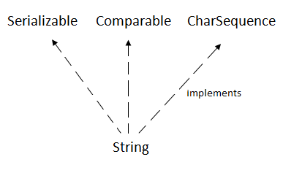
Java.lang.string

Slide 4
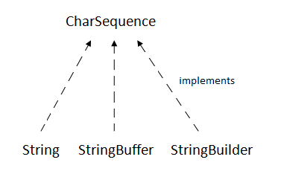
Charsequence interface

Slide 5
Creating string in java
Note: Strings in Java are not primitive types (like int, char, etc). Instead, all strings are objects of a predefined class named String.
And, all string variables are instances of the String class.

Slide 6
How to create a string object?
There are two ways to create String object:
By string literal
By new keyword

Slide 7
1) String Literal
Java String literal is created by using double quotes
String s="welcome";
Each time you create a string literal, the JVM checks the "string constant pool" first. If the string already exists in the pool, a reference to the pooled instance is returned. If the string doesn't exist in the pool, a new string instance is created and placed in the pool.

Slide 8
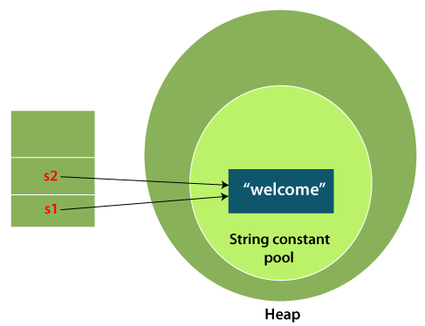
Creating two strings

Slide 9
Create a String in Java
class Main {
public static void main(String[] args) {
// create strings
String first = "Java";
String second = "Python";
String third = "JavaScript";
// print strings
System.out.println(first); // print Java
System.out.println(second); // print Python
System.out.println(third); // print JavaScript
}
}

Slide 10
Why Java uses the concept of String literal?
To make Java more memory efficient (because no new objects are created if it exists already in the string constant pool).

Slide 11
2) By new keyword
String s=new String("Welcome");//creates two objects and one reference variable
In such case, JVM will create a new string object in normal (non-pool) heap memory, and the literal "Welcome" will be placed in the string constant pool. The variable s will refer to the object in a heap (non-pool).

Slide 12
Java String Operations
Java String provides various methods to perform different operations on strings. We will look into some of the commonly used string operations.

Slide 13
1. Get length of a String-length() method
class Main {
public static void main(String[] args) {
// create a string
String greet = "Hello! World";
System.out.println("String: " + greet);
// get the length of greet
int length = greet.length();
System.out.println("Length: " + length);
}
}

Slide 14
2. Join Two Java Strings – concat() method
class Main {
public static void main(String[] args) {
// create first string
String first = "Java ";
System.out.println("First String: " + first);
// create second
String second = "Programming";
System.out.println("Second String: " + second);
// join two strings
String joinedString = first.concat(second);
System.out.println("Joined String: " + joinedString);
}
}

Slide 15
About Strings
Strings are defined as an array of characters.
The difference between a character array and a string is the string is terminated with a special character ‘\0’. Since arrays are immutable(cannot grow), Strings are immutable as well.
Whenever a change to a String is made, an entirely new String is created. Concatenation is the process of joining end-to-end.

Slide 16
Concat method
The Java String concat() method of String class concatenates one string to the end of another string. This method returns a string with the value of the string passed into the method, appended to the end of the string.

Slide 17
‘+’ Operator
+ operator is used for concatenating strings on either side and is used just likely we are up to adding two numbers, henceforth providing us the flexibility to add on either side

Slide 18
Differences between + and concat
Factor 1: Number of arguments the concat() method and + operator takes
concat() method takes only one argument of string and concatenates it with other string.
+ operator takes any number of arguments and concatenates all the strings.

Slide 19
Differences between + and concat
Factor 2: Type of arguments
string concat() method takes only string arguments, if there is any other type is given in arguments then it will raise an error.
+ operator takes any type

Slide 20
Differences between + and concat
Factor 3: concat() method raises java.lang.NullPointer Exception
concat() method throws NullPointer Exception when a string is concatenated with null
+ operator did not raise any Exception when the string is concatenated with null.

Slide 21
Differences between + and concat
Factor 4: Creates a new String object
concat() method takes concatenates two strings and returns a new string object only string length is greater than 0, otherwise, it returns the same object.
+ operator creates a new String object every time irrespective of the length of the string.

Slide 22
Differences between + and concat
Factor 5: Performance
concat() method is better than the + operator because it creates a new object only when the string length is greater than zero(0) but the + operator always creates a new string irrespective of the length of the string.

Slide 23
HOW + is implemented
String ab = "ab";
String cd = "cd";
String both = ab + cd; //both = "abcd"
Where's that implemented?
String both = new StringBuilder().append(ab).append(cd).toString();

Slide 24
3. Compare two Strings
class Main {
public static void main(String[] args) {
// create 3 strings
String first = "java programming";
String second = "java programming";
String third = "python programming";
// compare first and second strings
boolean result1 = first.equals(second);
System.out.println("Strings first and second are equal: " + result1);
// compare first and third strings
boolean result2 = first.equals(third);
System.out.println("Strings first and third are equal: " + result2);
}
}

Slide 25
Comparing two strings
Note: We can also compare two strings using the == operator in Java.
However, this approach is different than the equals() method.

Slide 26
Java String compare
We can compare String in Java on the basis of content and reference.
It is used in authentication (by equals() method), sorting (by compareTo() method), reference matching (by == operator) etc.
By Using equals() Method
By Using == Operator
By compareTo() Method

Slide 27
Using equals() method
The String class equals() method compares the original content of the string. It compares values of string for equality. String class provides the following two methods:
public boolean equals(Object another) compares this string to the specified object.
public boolean equalsIgnoreCase(String another) compares this string to another string, ignoring case.

Slide 28
2) By Using == operator
The == operator compares references not values.

Slide 29
By Using compareTo() method
The String class compareTo() method compares values lexicographically and returns an integer value that describes if first string is less than, equal to or greater than second string.
Suppose s1 and s2 are two String objects. If:
s1 == s2 : The method returns 0.
s1 > s2 : The method returns a positive value.
s1 < s2 : The method returns a negative value.

Slide 30
Immutable String in Java
A String is an unavoidable type of variable while writing any application program. String references are used to store various attributes like username, password, etc. In Java, String objects are immutable. Immutable simply means unmodifiable or unchangeable.
Once String object is created its data or state can't be changed but a new String object is created.

Slide 31
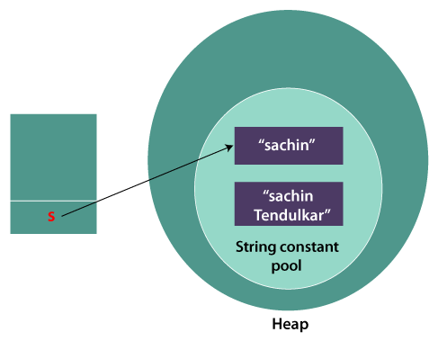
Immutable String

Slide 32
Why String objects are immutable in Java?
As Java uses the concept of String literal. Suppose there are 5 reference variables, all refer to one object "Sachin". If one reference variable changes the value of the object, it will be affected by all the reference variables. That is why String objects are immutable in Java.

Slide 33
String immutable reasons
Following are some features of String which makes String objects immutable.
1. ClassLoader:
A ClassLoader in Java uses a String object as an argument. Consider, if the String object is modifiable, the value might be changed and the class that is supposed to be loaded might be different.

Slide 34
String immutable reasons
2. Thread Safe:
As the String object is immutable we don't have to take care of the synchronization that is required while sharing an object across multiple threads.

Slide 35
String immutable reasons
3. Security
As we have seen in class loading, immutable String objects avoid further errors by loading the correct class. This leads to making the application program more secure. Consider an example of banking software. The username and password cannot be modified by any intruder because String objects are immutable. This can make the application program more secure. As we have seen in class loading, immutable String objects avoid further errors by loading the correct class. This leads to making the application program more secure. Consider an example of banking software. The username and password cannot be modified by any intruder because String objects are immutable. This can make the application program more secure.

Slide 36
String immutable reasons
4. Heap Space
The immutability of String helps to minimize the usage in the heap memory. When we try to declare a new String object, the JVM checks whether the value already exists in the String pool or not. If it exists, the same value is assigned to the new object. This feature allows Java to use the heap space efficiently.

Slide 37
Why String class is Final in Java?
The reason behind the String class being final is because no one can override the methods of the String class. So that it can provide the same features to the new String objects as well as to the old ones.

